Slide 1
E-MARKETING
(INTERNET MARKETING)

Slide 2
E-MARKETING
Marketing:
A comprehensive process that involves every aspect of a business from designing its products, setting the pricing strategy to analysing sales statistics and collecting customer feedback.
E-Marketing:
Refers to using technology such as the internet, website and email, sms, including its wide variety of options and tools to conduct your marketing activities and achieve your marketing objectives.

Slide 3
Cont..
Perhaps no area of business has been more affected by Internet and mobile platform technologies than marketing and marketing communications.
As a communications tool, the Internet affords marketers new ways of contacting millions of potential customers at costs far lower than traditional media.
The Internet also provides new ways—often instantaneous and spontaneous—to gather information from customers, adjust product offerings, and increase customer value.
The Internet has spawned entirely new ways to identify and communicate with customers, including search engine marketing, social network marketing, behavioral targeting, and targeted e-mail, among others.

Slide 4
The e-Marketing Concept
The objectives of marketing are to:
get the right product
promoted in the right way
sold at the right price
distributed at the right place
profitably

Slide 5
THE E-MARKETING CONCEPT
Examples of e-Marketing include:
online surveys to conduct market research
web site to display and sell your products
internet advertising to promote your business
software to collect and analyse your customer information

Slide 6
THE E-MARKETING CONCEPT
The Key to e-Marketing:
The key to successful e-Marketing in today's business environment is to place your clients in control. Allow them to choose how often and what type of messages they receive, thus creating a more meaningful relationship with your business.
This is commonly referred to as Permission Marketing.
Your e-Marketing messages and tools should aim to deliver information that the consumer wants - that they perceive to be valuable.

Slide 7
INTEGRATING E-MARKETING INTO YOUR BUSINESS
e-Marketing is not an alternative to your existing Marketing Plan, in fact you may already have a "Marketing Plan" that identifies your marketing objectives, outlines your key strategies designed to achieve those objectives, and guides your daily marketing activities.
With e-Marketing you can develop techniques to enhance this existing plan to make your marketing activities more effective (smarter) more efficient (cheaper) and you may even find that you can tap into new markets both locally and overseas.

Slide 8
HOW WOULD E-MARKETING ENHANCE MY EXISTING MARKETING PLAN
With the use of internet-based product catalogues you can reduce your printing costs and maintain a higher quality of product information for your customers.
By utilising marketing information systems you can analyse your sales information to make more informed decisions and customers all over the world can view your products with a website.

Slide 9
CAN MY BUSINESS AFFORD E-MARKETING?
The cost of e-Marketing depends on which strategies you choose to implement.
Any business can start using simple e-Marketing techniques such as email, newsletters, computer based data management and internet research by purchasing a computer and connecting to the internet which can be achieved for less than 50,000Tk.
Businesses can also spend many thousands of takas utilizing the services of a professional e-Marketing firm to create and implement a complete e-Marketing package. The choice is yours!

Slide 10
Online Marketing Communications
Marketing communications have a duel purpose: branding and sales.
One purpose of marketing communication is to develop and strengthen a firm’s brands by informing customers about the differentiating features of the firm’s products and services.
Again, marketing communications are used to promote sales directly by encouraging the consumer to buy products (the sooner, the better).
Promotional sale communications almost always suggest that the customer “buy now” and they make offers to encourage immediate purchase.
Branding communications rarely encourage consumers to buy now, but instead focus on extolling the differentiable benefits of consuming the products or service.

Slide 11
Segmentation and Targeting Overview
Companies need to clearly understand the needs and behavior of its target market. It must have in-depth:
  Market knowledge,
  A savvy segmentation,
  Targeting strategy.
E-marketing strategic planning occurs in two highly interrelated tiers:
  The first tier = segmentation, targeting, differentiation, and positioning,
  Second tier = the 4Ps (Price, product, place, promotion) and CRM (Customer Relationship Management).

Slide 12
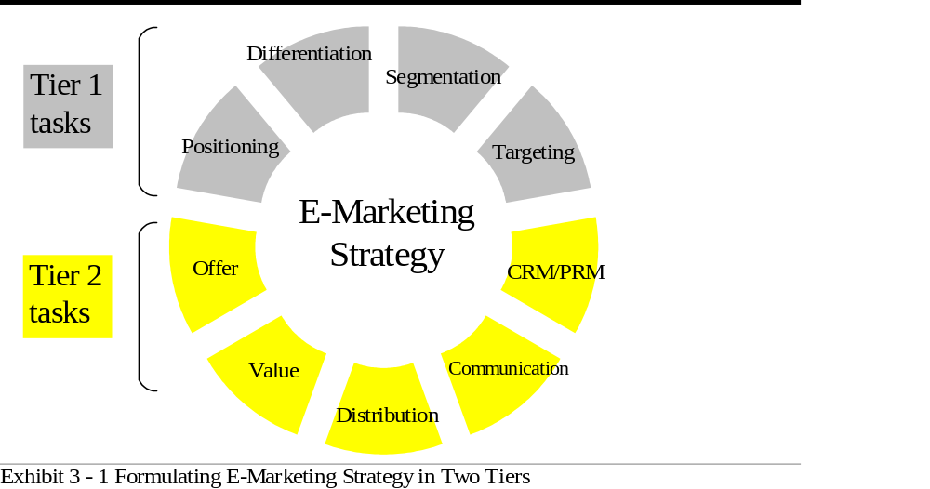
©2006 Prentice Hall

Slide 13
Segmentation and Targeting Overview
Marketing segmentation = Market segmentation is the process that companies use to divide large heterogeneous markets into small markets that can be reached more efficiently and effectively with products and services that match their unique needs.
Targeting = the process of selecting the market segments that are most attractive to the firm and selecting an appropriate segment coverage strategy.

Slide 14
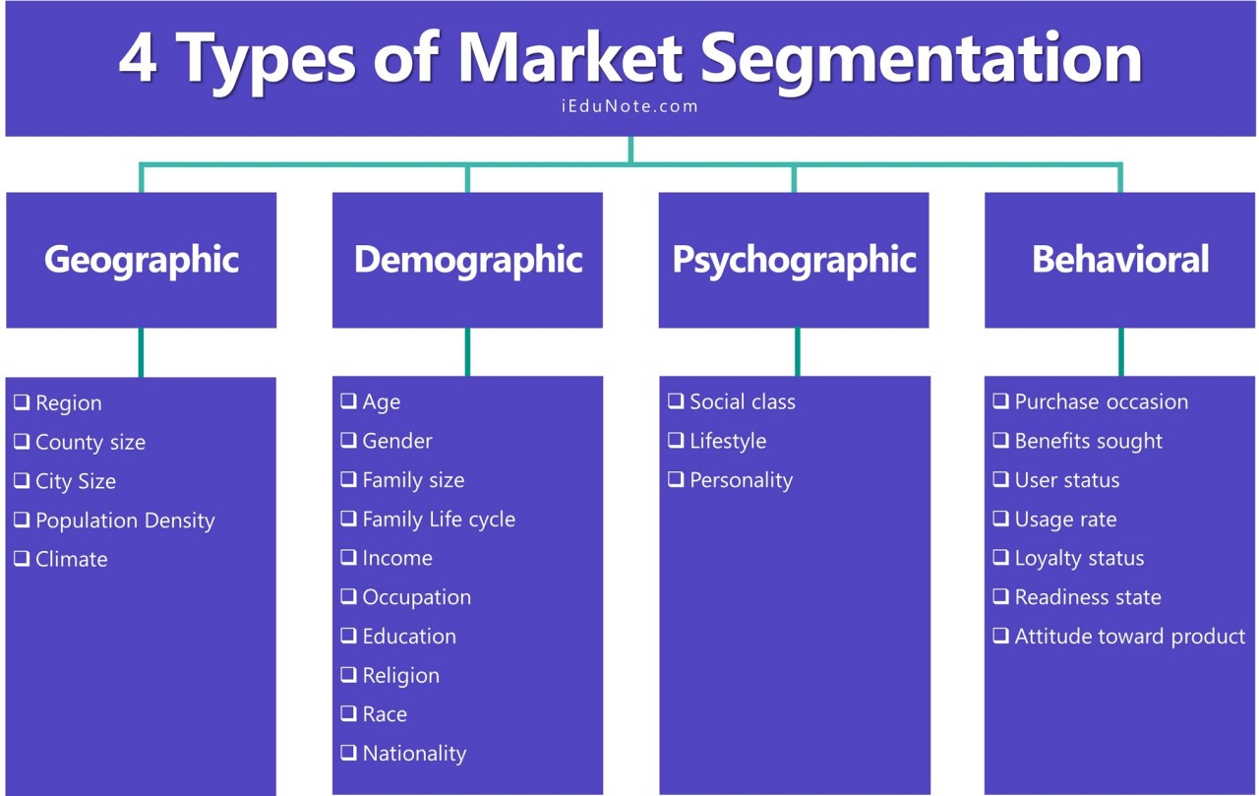

Slide 15
What makes a good market segment
In order to have a segment that has meaning to the organization there are certain criteria that must be met.
Measurable: The segment must be large enough that it can be measured.
Profitable: Will segmenting the market create profit for the organization?
Stability: It must be stable enough that it does not vanish after some time.
Reachable: Can this segment of the market be reached by the company’s marketing programs in a cost-effective manner?
Internally homogeneous: Do the customers in the segment prefer the same product qualities?
Externally heterogeneous: The customers in different segments should all have different preferences.

Slide 16
Geographical Segment

Slide 17
Geographic Segments
Geographic location of computers is not important to users accessing Web sites, but it is very important to organizations with an Internet presence.
Most firms target specific cities, regions, states, or countries with their product offerings
= develop multisegment strategies based on geographics.
Product distribution strategy is a driving force behind geographic segmentation:
  Companies want to reach only customers in countries where it distributes products.
  Firms offering services online will only sell to geographic areas where they can provide customer service.
  Companies must examine the proportion of Net users in its selected geographic targets before deciding to serve the Web community.

Slide 18
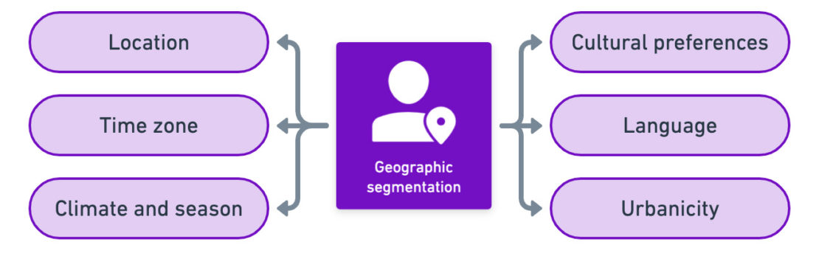

Slide 19
Important Geographic Segments for E-Marketing
English is no longer the language of most Web pages and online bulletin boards, a major change from just two years ago.
Top Internet languages:
  English (42%),
  Japanese (9%),
  Chinese (9%),
  Spanish (7%),
  German (7%).
Huge implications for e-marketers desiring to reach global markets via the Internet
Until more online text appears in local languages, users in those countries will not able to participate in e-commerce or other online activities.

Slide 20
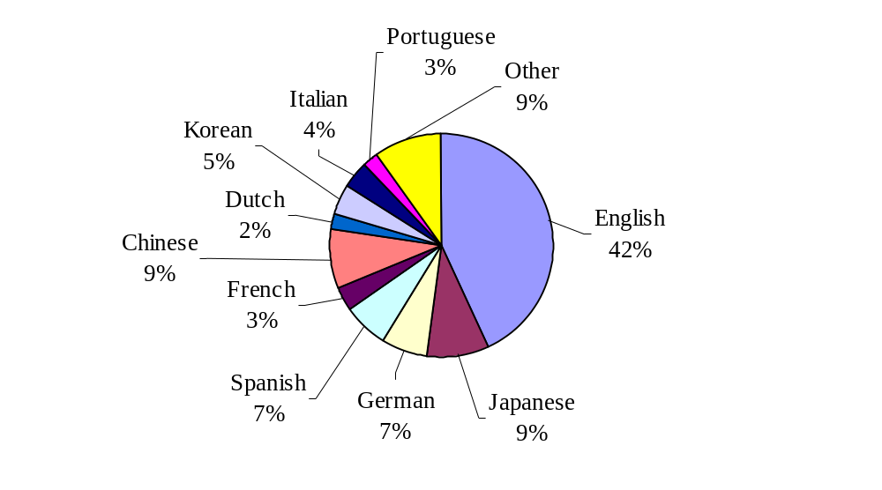
Less Than Half of Web Users Access in English
Source: Adapted from Cutitta (2002)

Slide 21
Demographic Segments

Slide 22
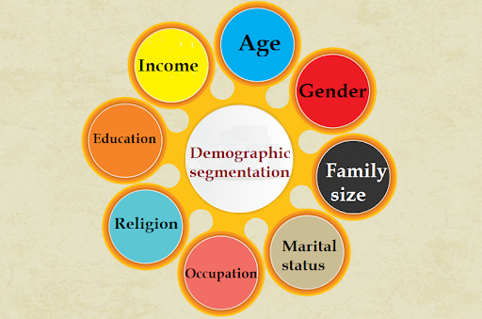
Demographic Segments
Demographic segmentation is market segmentation according to age, race, religion, gender, family size, ethnicity, income, and education.
This helps brands spend their advertising and marketing budget more efficiently. Instead of going after their entire market, they’re able to show relevant messages to people more likely to care.

Slide 23
Age & Life Cycle
Human needs and wants change with age.
Using age and life-cycle segmentation, some companies offer different products or adopts different marketing approaches for different age and life-cycle groups.
  For example, McDonald’s targets children, teens, adults, and seniors with different ads and media.
  Its ads directed at teens feature dance-beat music, adventure, and fast­paced cutting from scene to scene; ads to seniors are softer and more sentimental.

Slide 24
Gender
Gender segmentation involves dividing a market into different groups based on sex.
Gender segmentation is extensively used in clothing, cosmetics, and magazines.
Other marketers are also adopting gender segmentation.
  For example, although early toilet soaps were used by both sexes, many companies are now featuring unisex brands.
Gender segmentation is also widely used in the automobile industry. More and more car manufacturers are directing their advertisements to women.

Slide 25
Income
Income segmentation involves dividing a market into different income groups.
Marketers of products and services such as automobiles, clothing, cosmetics, and travel have found income segmentation very useful.
Companies with luxury goods and convenience services target well off consumers.
Income segmentation is also used to identify and target lower-income groups so that they can be approached with appropriate products, prices, and distribution outlets.

Slide 26
Occupation
Few years ago, the Internet = a place for the technologically- and financially-savvy.
Today = a place where residents from all professions find something of use.
Huge implications for e-commerce and advertising, and big changes are still taking place.

Slide 27
Occupation
Blue-collar workers:
  Are currently the fastest growing online occupational group.
  This group is busy surfing and exploring,
  Represent a major marketing opportunity because segment members have not yet developed site loyalty and have some different product and entertainment needs from users in other professions.
Other fast growing occupational groups include homemakers (49%), service workers (37%), and salespeople (34%).
E-marketers can use such facts about occupational segments online as information and then knowledge to drive e-marketing strategy.

Slide 28
Education
Amount of education seems to make a difference when it comes to online access.
Of those individuals with a high school education or less, only 39% were online as of year-end 2010 compared to 82% of individuals with a university degree or more.
Even some college education boosted Internet usage, with the segment reaching 71% penetration.
Online banking is also more popular with educated men than women.

Slide 29
Teens and Children
  “The Net Generation” or Generation Y,
  One of the fastest-growing online niches.
  12-17 year old: send e-mail (81%), instant messages (70%), play games, and purchase music, tickets, and videos,58% use the Internet for homework
  For all children and teenagers, the majority of time spent on the Internet has been labeled “wasted time” because the majority of online use is for entertainment, and not education or learning (Richtel, 2012).
  Teens’ repeated requests for online access is what leads families into computer and ISP purchases.

Slide 30
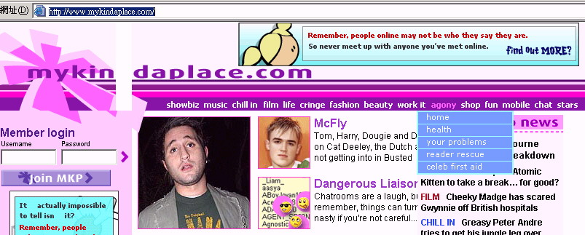
.
Target to teenage (11-18 years old) girls
  The site sports bright pink, blue, and purple colors.
  Age-appropriate language: link names on the site are labeled
  Play “Virtual Boyfriend”, Take fun quizzes , chat, and send e-cards to friends.
  Site managers monitor chat rooms so parents don’t pull the plug
Revenues from:
  Sponsorship
    Site’s 10 channels are sponsored by brands targeting teens.
  Merchandise sales
    Payment: smart cards, and parents’ credit cards.

Slide 31
Teens and Children
Driving future growth in this market is the fact that 60-70% of all schools now have Internet access.
This market:
  Is not impressed with brand names online;
  wants utility + particular activities.
Teens spread the news through online word of mouth (viral marketing).
38% of teens share their online findings with friends = a great marketing opportunity.

Slide 32
Teens and Children
One big problem = payment:
  They do not have credit cards for online purchases (only 12% have purchased online).
  Some are allowed to use their parents’ credit cards.
  Those over 16 years of age can obtain a debit card.
  Innovative approaches such as “Splash Plastic” prepaid cards or “cyber allowance” accounts deposited at designated online retailers have emerged.
Important characteristics of this market = the need to be honest about marketing tactics: revealing the motives behind asking for personal information.
Teens are eager to play online games, download music and movies, and sign up for sales promotion premiums and free samples.

Slide 33
Psychographic Segments

Slide 34
Psychographic Segments
Psychographic segmentation is dividing your market based upon consumer personality traits, values, attitudes, interests, and lifestyles.
Segmentation will allow you to better develop and market your products because there will be a more precise match between the product and each segment's needs and wants.
User psychographics include:
  Personality: Traits (other-oriented / self-oriented)
  and habits,
  Values: Deeply held convictions (religious beliefs),
  Lifestyle: Non-product-related behavior
  Activities: (playing sports or eating out),
  Interests: Attitudes and beliefs people hold.

Slide 35
Social Class & Life Style
Social class has a strong effect on preferences in products, services, and retail outlets—many companies design products or services for specific social classes, incorporating features that appeal to these classes.
People’s interest in various products is affected by their lifestyles, and products bought by the buyers reflect their lifestyles.
Consumer lifestyles are being increasingly used by marketers to segmenting their markets.

Slide 36
Attitudes And Behaviors
How do attitudes and behavior differ?
Attitudes:
  Internal evaluations about people, products, and other objects,
  Either positive or negative,
  The evaluation process occurs inside a person’s head.

Slide 37
Attitudes And Behaviors
Behavior:
  Refers to what a person physically does (calling a 1-800 number to order, shopping, or purchasing a product),
  Product behaviors are such a vital segment descriptor that they form an entirely separate category.

Slide 38
Lifestyle Impacts
There are some worrisome impacts to intensive Internet use.
The Internet may be causing a decline in traditional social activities---such as talking with neighbour, it may also be encouraging users to spend less time with family and friends and more time working whether at home or at the office--------------from the marketing point of view, the more time individuals spend using the Internet, “the more they turns their back on traditional media,” according to Stanford University study.
For every additional hour users spend online, they reduce their corresponding time spent with traditional media.
Therefore, traditional media are competing with the Internet for consumer attention and so far, the Internet appears to be gaining.

Slide 39
Attitudes Toward Technology
Marketers believe that demographics are not helpful in predicting who will purchase online.
BUT it is important to know which demographic target is online.
The segment’s attitudes toward technology determine whether or not these users will buy when they surf the Web.

Slide 40
Attitudes Toward Technology
Forrester Research measures consumer and business attitudes toward technology.
Technographic segmentation is a market research analysis tool used to identify and profile the characteristics and behaviors of consumers through the process of market segmentation.
The system, Technographics, works by combining three specific variables:
  Determine if a person is optimistic or pessimistic toward technology,
  Measure a user’s income level ( important determinant of online shopping behavior),
  Query users about their primary motivation for going online.

Slide 41
Attitudes Toward Technology
Forrester’s research revealed some interesting findings:
Technology optimism declines with age:
  Older users tend to have a more negative attitude toward technology,
  Their attitudes may be less negative if they use a PC at work or live in one of the largest 50 U.S. cities,
Men tend to be more optimistic,
Peer pressure can increase optimism in all demographic groups,
Income:
  40% of high-income citizens are optimistic,
  Certain low-income groups such as college students and young families are also optimistic about technology.

Slide 42
Attitudes Toward Technology
How do these findings translate to online purchasing?
Twice as many high-income optimists shop online (19%) compared with other groups.
Only 2% of low-income pessimists shop online and, therefore, are not a good target for e-commerce firms.
Combining Technographics with adopter categories,
  Early adopters = high-income technology optimists = the first consumers to shop online.
  Laggards = low-income pessimists = last to shop online.
Technographic segments can be used to profile customers who shop online and to determine where to allocate resources to attract more of the same.

Slide 43
Community Effects: Social Contagion in Social Networks
For a physical retail store, the most important factor in shaping sales is location.
If you are located where thousands of people pass by every day, you will tend to do well.
But for Internet retailers, physical location has almost no consequence as long as customers can be served by shipping services such as UPS or their services can be downloaded to anywhere.
In general, there is a relationship between being a member of a social network and purchasing decisions.

Slide 44
Continue….
Yet the relationship between “connectedness” (either offline or online) and purchase decisions is not straightforward or simple.
People who score in the top 10%–15% of connectedness “do their own thing” to differentiate themselves and often do not share purchase decisions with friends.
In fact, highly connected users often stop purchasing what their friends purchase. One can think of them as iconoclasts.
The middle 50% of connected people very often share purchase patterns of their friends.
A Forrester Research study found that less than 2% of online purchases could be traced back to social networks, although for short-term, flash sales, the percentage rises to 6% (Forrester Research, 2011a).

Slide 45
Continue….
Membership in social networks has a large influence on discovering new independent music, but less influence on already well-known products (Garg, 2009).
Membership in an online brand community like Drop Away’s Facebook page and community has a direct effect on sales (Adjei, et al., 2009).
Amazon’s recommender systems (“Consumers who bought this item also bought ...”) create co-purchase networks where people do not know one another personally, but nevertheless triple the influence of complementary products (Oestreicher-Singer and Sundararajan, 2008).
The value of social networks to marketers rests on the proposition that brand strength and purchase decisions are closely related to network membership, rank, prominence, and centrality.

Slide 46
Behavior Segments

Slide 47
Consumer Behaviour Model
Behavioural segmentation involves dividing a market into groups based on consumer knowledge, attitude, use, or response to a product.
Once firms have an understanding of who is online, they need to focus on how consumers behave online.
The study of consumer behaviour is a social science discipline that attempts to model and understand the behaviour of humans in a marketplace.
Models of consumer behaviour attempt to predict or “explain” what consumers purchase and where, when, how much, and why they buy.
The expectation is that if the consumer decision-making process can be understood, firms will have a much better idea how to market and sell their products

Slide 48
Profile of Online Consumers
Consumer behaviour models seek to predict the wide range of decisions that consumers make on the basis of background demographic factors and on a set on intervening, more immediate variables that shape the consumer’s ultimate decisions.
Background factors are cultural, social and psychological in nature.
It is important to first understand why people choose the Internet channel to conduct transactions.
Culture is the broadest factor in consumer behaviour because it shape basic human values, wants perceptions and behaviours.
  Culture creates basic expectations that consumers bring to the marketplace such as what should be bought in different markets, how things should be bought, and how things should be paid for.
  Generally culture affects an entire nation and takes on major significance in international marketing.

Slide 49
Continue…
Among the important social factors that shape consumer behaviour are the many reference groups to which all consumers “belong”, either as direct participating members or as indirect members by affiliation, association or aspiration.
Direct reference groups include one’s family, profession or occupation, religion, neighbourhood etc.
Indirect reference groups include one’s life-cycle stage, social class and lifestyle group.
Within each of these reference groups, there are viral influencers who because of their personality, skills or other factors, influence the behaviour of others.
Marketers seek out viral influencers in their communications and promotional efforts because of their influence over other people.

Slide 50
Clickstream Behaviour
Clickstream behaviour refers to the transaction log that consumers establish as they move about the Web, from search engine to a variety of sites, then to a single site, then to a single page, and then, finally, to a decision to purchase.
These precious moments are similar to “point-of-purchase” moments in traditional retail.
A study of over 10,000 visits to an online store found that detailed and general clickstream behaviour were as important as customer demographics and prior purchase behaviour in predicting a current purchase (Van den Poel and Buckinx, 2005).
Clickstream marketing takes maximum advantage of the Internet environment. For instance, the success of search engine marketing (the display of paid advertisements on Web search pages) is based in large part on what the consumer is looking for at the moment and how they go about looking (detailed clickstream data). After examining the detailed data, general clickstream data is used (days since last visit, past purchases).

Slide 51
Behavior Segments
Two behavioral segmentation variables are:
Benefit segmentation:
  Benefit segmentation forms groups of consumers based on the benefits they desire from the product.
  “70% of online shoppers can be segmented into two groups:
    Bargain hunters: includes Hooked, Online & Single (16%), Hunter-Gatherers (20%)
    Convenience shoppers: includes Time-Sensitive Materialists (17%), brand loyalists (19%), E-Bivalent Newbies (5%), and Clicks & Mortars (23%).”
Product usage:
  Light, medium and heavy product usage.
  Brand loyal, loyal to the competitive product, switchers (who don’t care which brand they use), and nonusers of the product.

Slide 52
Shoppers: Browsers and Buyers
Although the Internet audience still tends to be concentrated among the well educated, affluent, and youthful, the audience is increasingly becoming more diverse.
Clickstream analysis shows us that people go online for many different reasons.
Online shopping is similarly complex.
The significance of online browsing for offline purchasing should not be underestimated.
Although it is difficult to precisely measure the amount of offline sales that occur because of online product research, several different studies have found that about one-third of all offline retail purchasing is influenced by online product research, blogs, banner ads, and other Internet exposure.

Slide 53
Continue…
The offline influence varies by product.
E-commerce is a major conduit and generator of offline commerce.
The reverse is also true: online traffic is driven by offline brands and shopping. While online research influences offline purchases, it is also the case that offline marketing media heavily influence online behaviour including sales.
Traditional print media (magazines and newspapers) and television are by far the most powerful media for reaching and engaging consumers with information about new products and directing them to the Web.
Online communities and blogging are also very influential but not yet as powerful as traditional media.

Slide 54
Cont…
This may be surprising to many given the attention to social networks as marketing vehicles, but it reflects the diversity of influences on consumer behaviour and the real-world marketing budgets of firms that are still heavily dominated by traditional media.
Even more surprising in the era of Facebook, face-to-face interactions are a more powerful influence than participation in online social communities.
These considerations strongly suggest that e-commerce and traditional commerce are coupled and should be viewed by merchants (and researchers) as part of a continuum of consuming behaviour and not as radical alternatives to one another.

Slide 55
Cont…
Commerce is commerce; the customers are often the same people.
Customers use a wide variety of media, sometimes multiple media at once.
The significance of these findings for marketers is very clear.
  Online merchants should build the information content of their sites to attract browsers looking for information, build content to rank high in search engines, put less attention on selling per sector, and promote services and products (especially new products) in offline media settings in order to support their online stores.

Slide 56
Why More People Don’t Shop Online
A final consumer behaviour question to address is: Why don’t more online Web users shop online?
About 27% of Internet users do not buy online.
Probably the largest factor preventing more people from shopping online is the “trust factor,” the fear that online merchants will cheat you, lose your credit card information, or use personal information you give them to invade your personal privacy, bombarding you with unwanted e-mail and pop-up ads.
Secondary factors can be summarized as “hassle factors,” like shipping costs, returns, and inability to touch and feel the product.
Consumers want good deals, bargains, convenience, and speed of delivery.
In short, consumers are looking for utility.

Slide 57
Cont…
On the other hand, in any seller-buyer relationship, there is an asymmetry of information.
The seller usually knows a lot more than the consumer about the quality of goods and terms of sale.
This can lead to opportunistic behaviour by sellers
Consumers need to trust a merchant before they make a purchase. Sellers can develop trust among online consumers by building strong reputations of honesty, fairness, and delivery of quality products—the basic elements of a brand.
Amazon’s book reviews from reviewers, and eBay’s feedback forum are examples of trust-building online mechanisms (NielsenWire, 2012; Opinion Research Corporation, 2009).

Slide 58
Cont…..
Online sellers who develop trust among consumers are able to charge a premium price for their online products and services (Kim and Benbasat, 2006, 2007; Pavlou, 2002).
A review of the literature suggests that the most important factors leading to a trusting online relationship are perception of Web site credibility, ease of use, and perceived risk (Corritore, et al., 2006).
An important brake on the growth of e-commerce is lack of trust.
Newspaper and television ads are far more trusted than online ads (Nielsen, 2011).
Personal friends and family are far more powerful determinants of online purchases than membership in social networks.
These attitudes have grown more positive over time, but new concerns about the use of personal information by Web marketers is raising trust issues among consumers again.

